Slide 1



PRISMS Center Center for PRedictive Integrated Structural Materials Science
CASM Tutorial – Intro
Brian Puchala, John C. Thomas, Anton Van der Ven
Anirudh Natarajan, John Goiri, Min-Hua Chen, Max Radin, Jonathon Bechtel, Elizabeth Decolvenaere, Anna Belak,
Naga Sri Harsha Gunda, Sanjeev Kolli
TMS ICME 2017
Thurs. May 24, 2017
Website: prisms-center.org

Slide 2
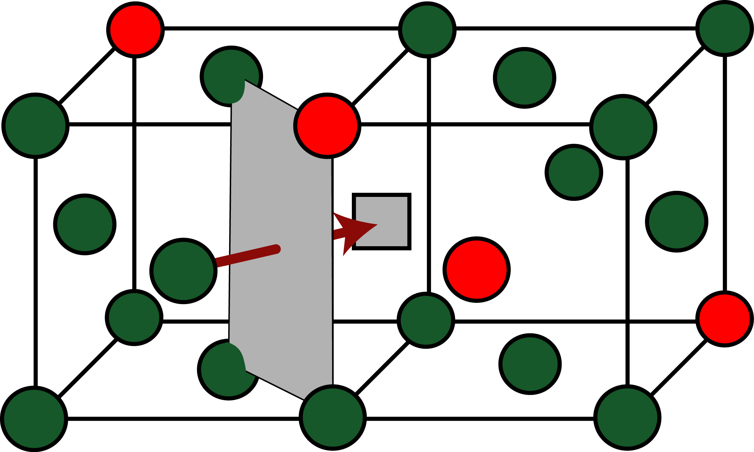
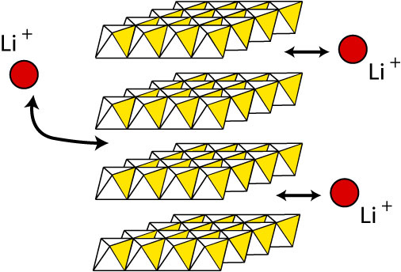
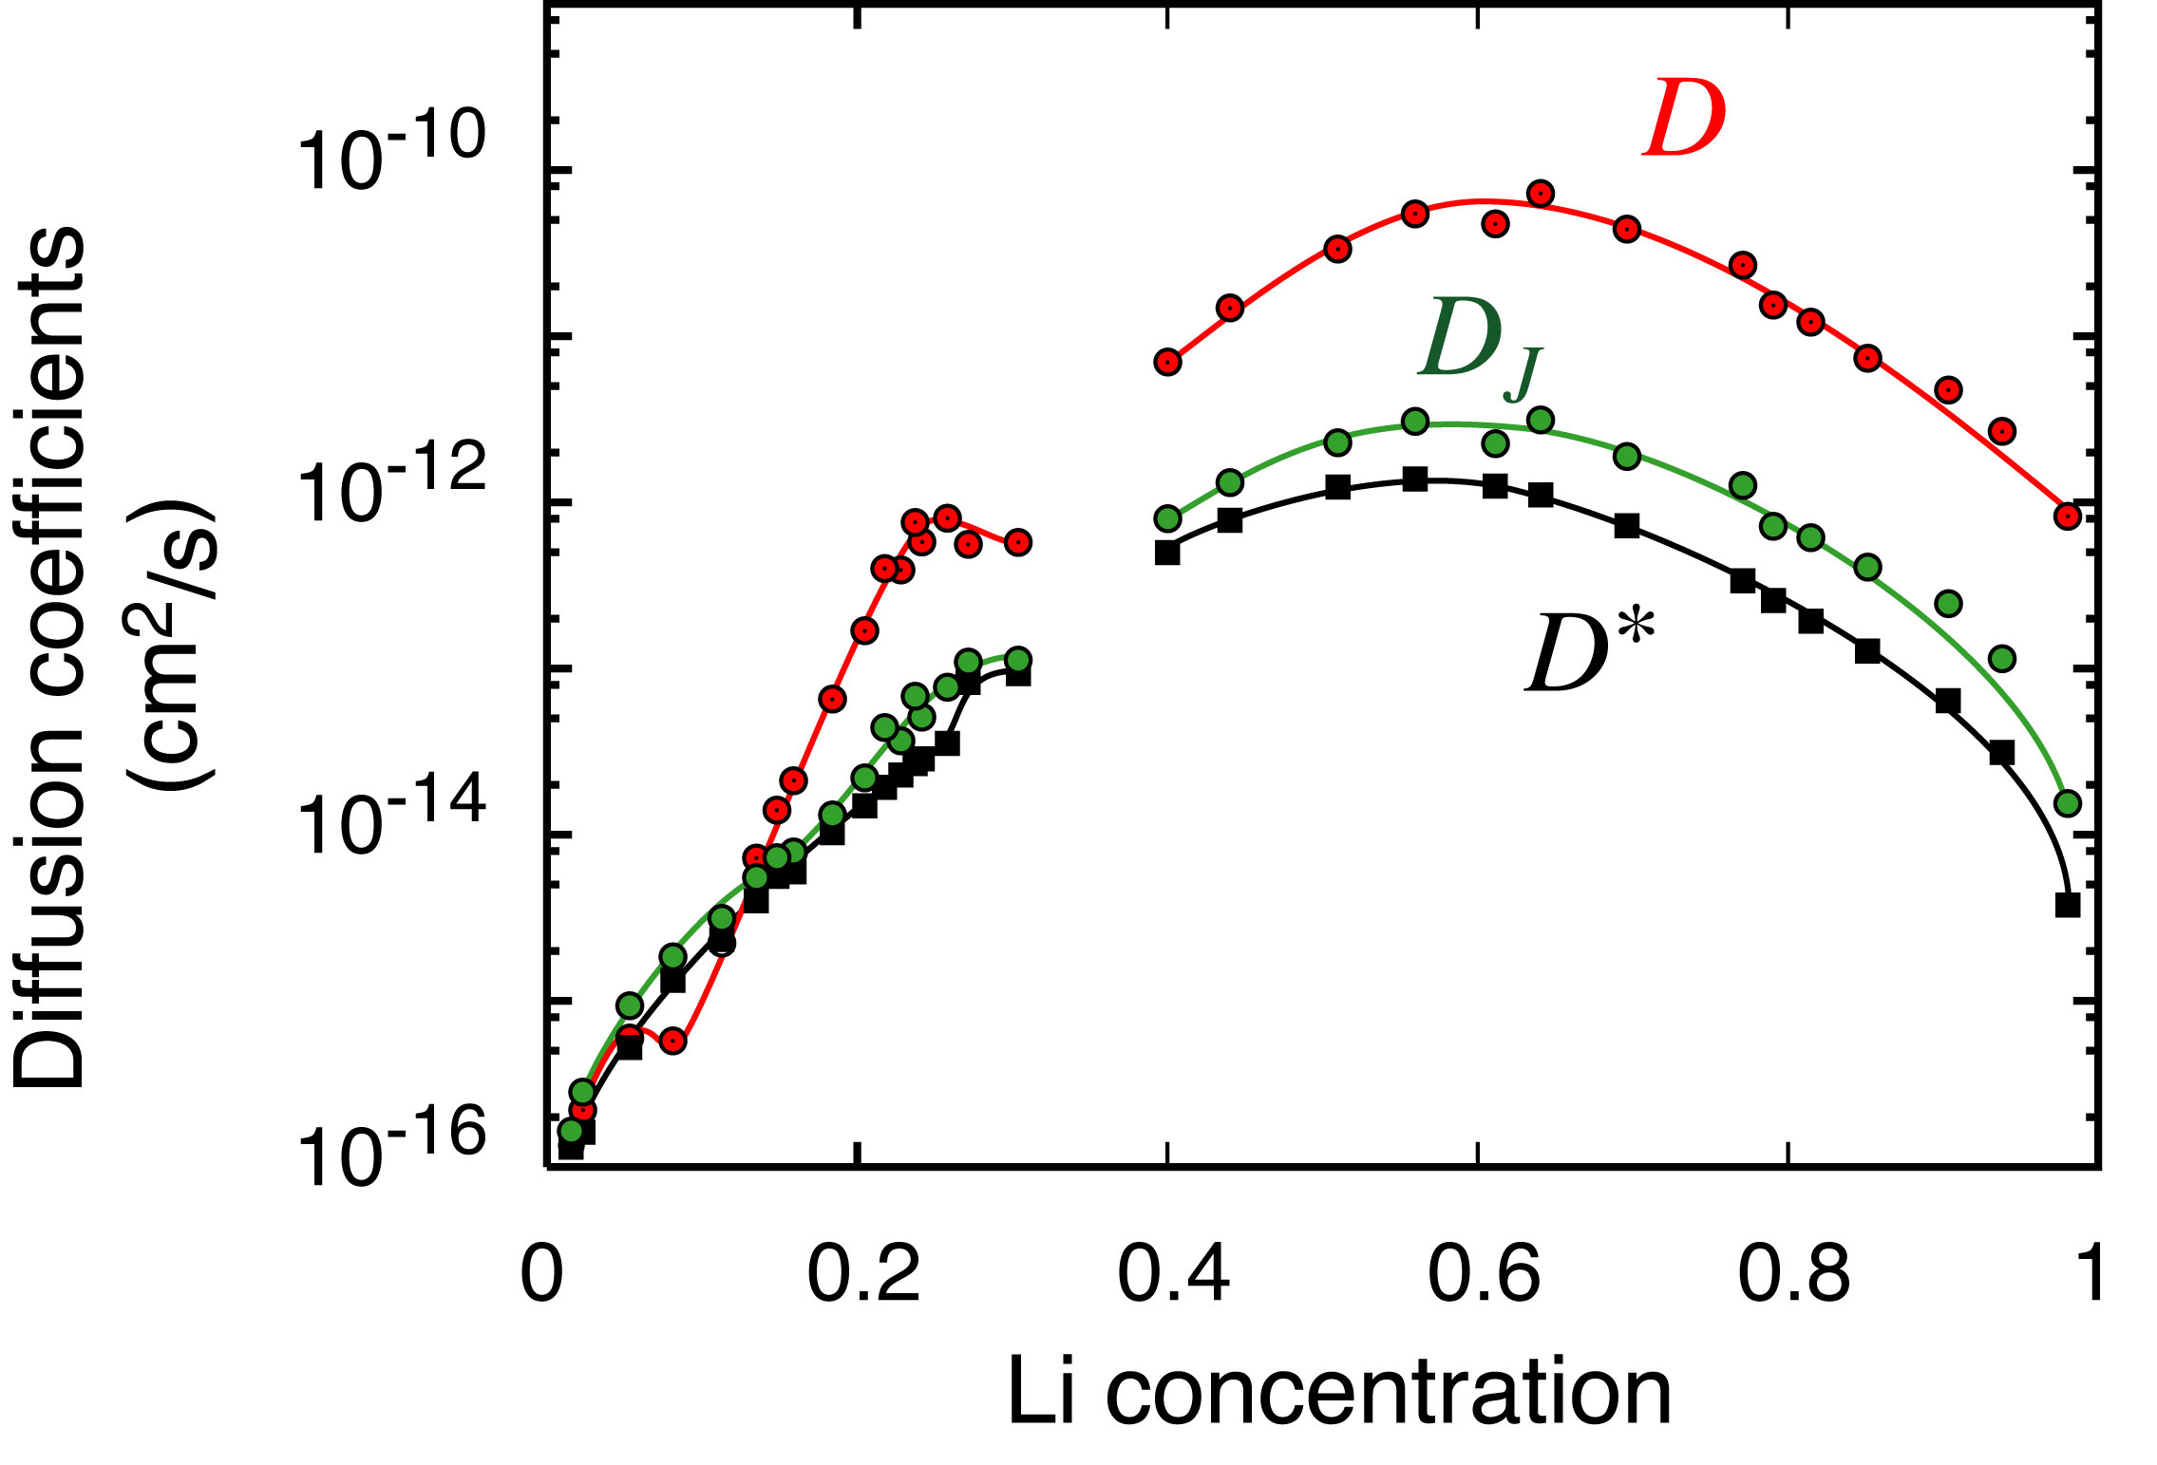
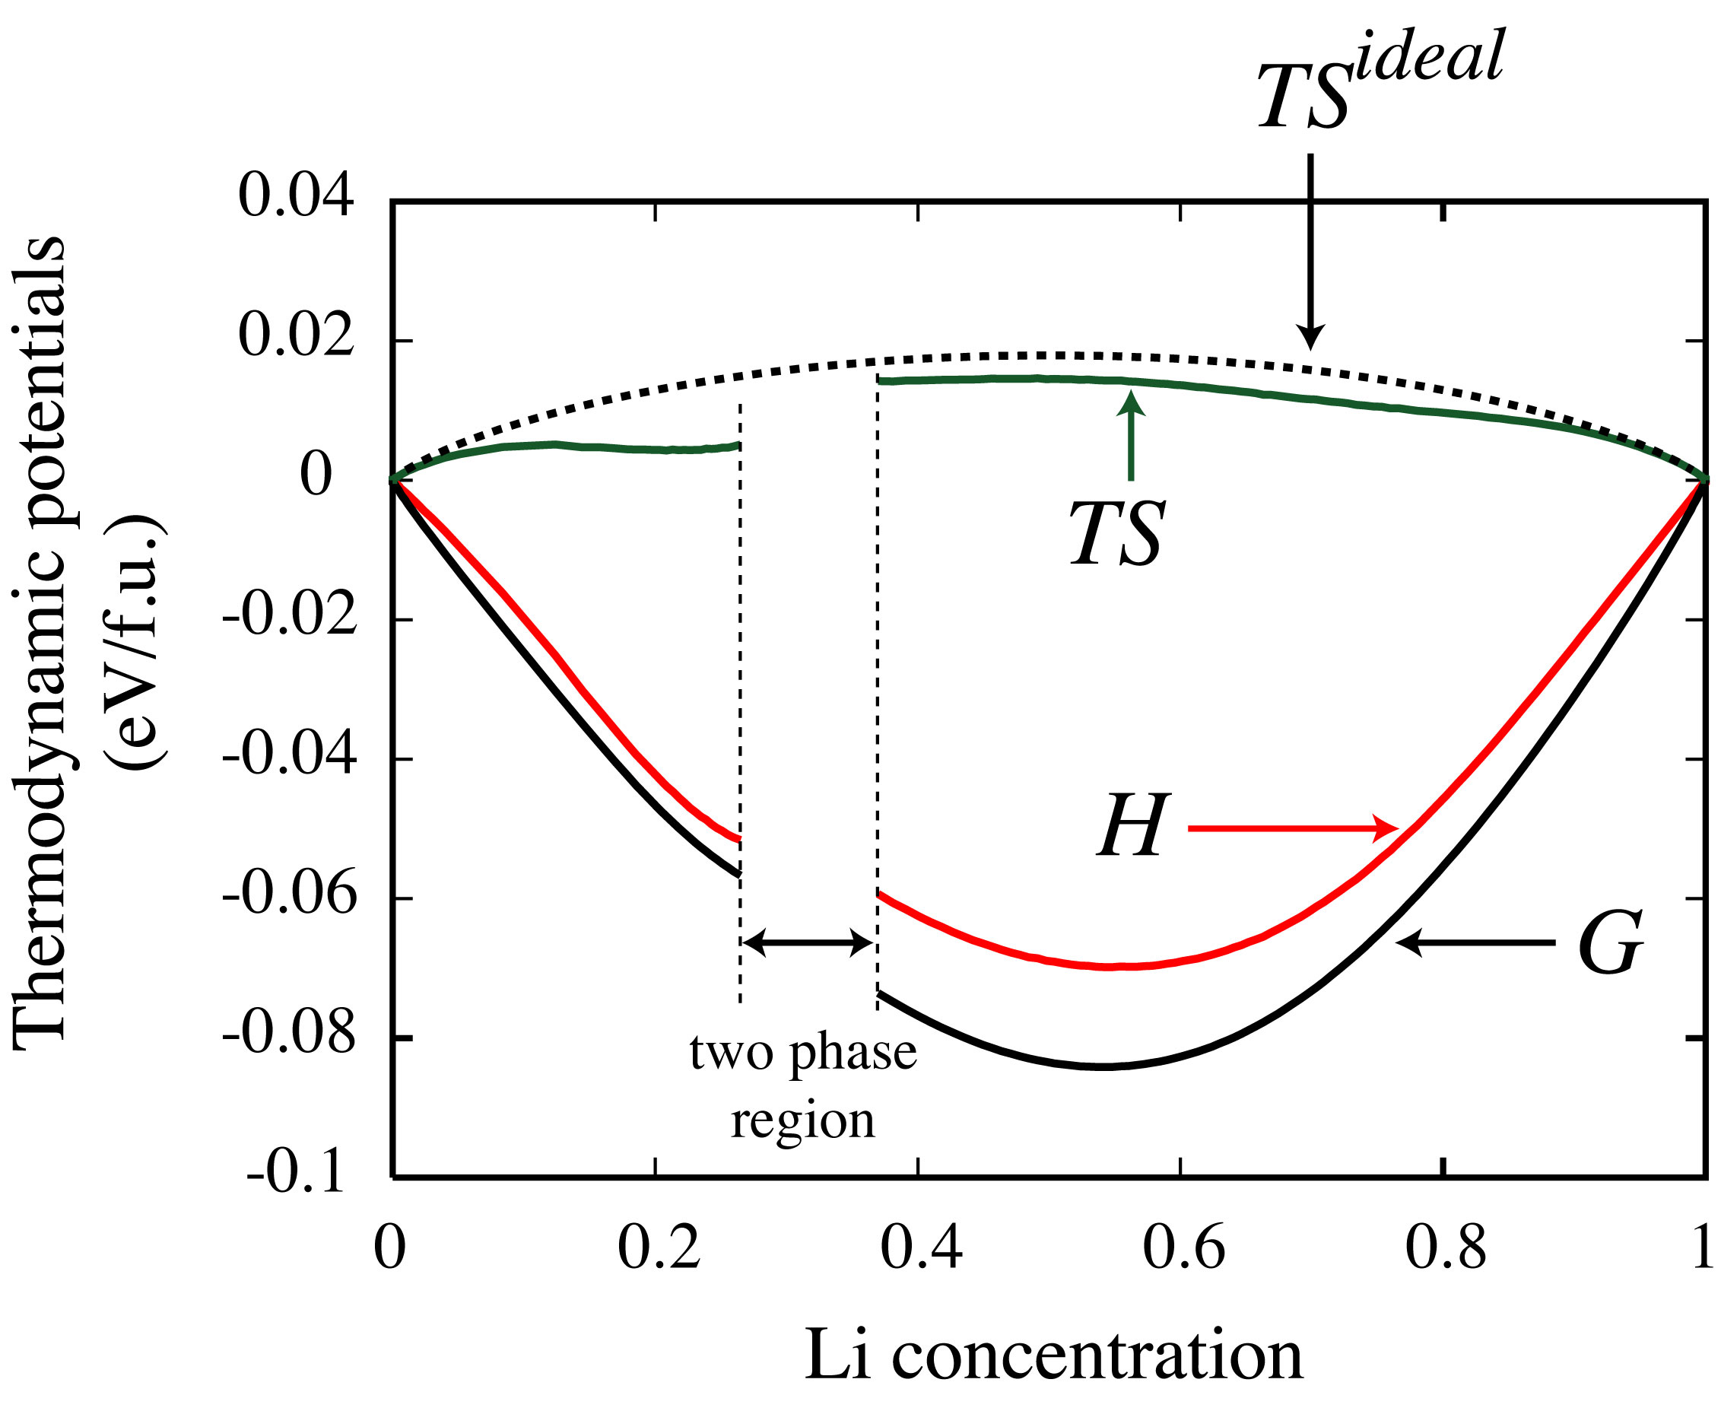
Electronic structure
Linking atomistic descriptions to phenomenological models of materials
Statistical Mechanics
Thermodynamics
Kinetics
Solid Mechanics
Phenomenological
descriptions
Notes:
Many of the most important or useful descriptions of materials behaviour are continuum descriptions.
Phase stability, mechanical properties, and microstructure evolution, can all be understood in terms of the free energy and kinetic coefficients of particular materials.
But of course these quantities fundamentally depend on atomistic interactions.
Our work is focused on using methods of statistical mechanics to link accurate ab initio electronic structure calculations of atomistic systems to phenomenological descriptions of materials.

Slide 3
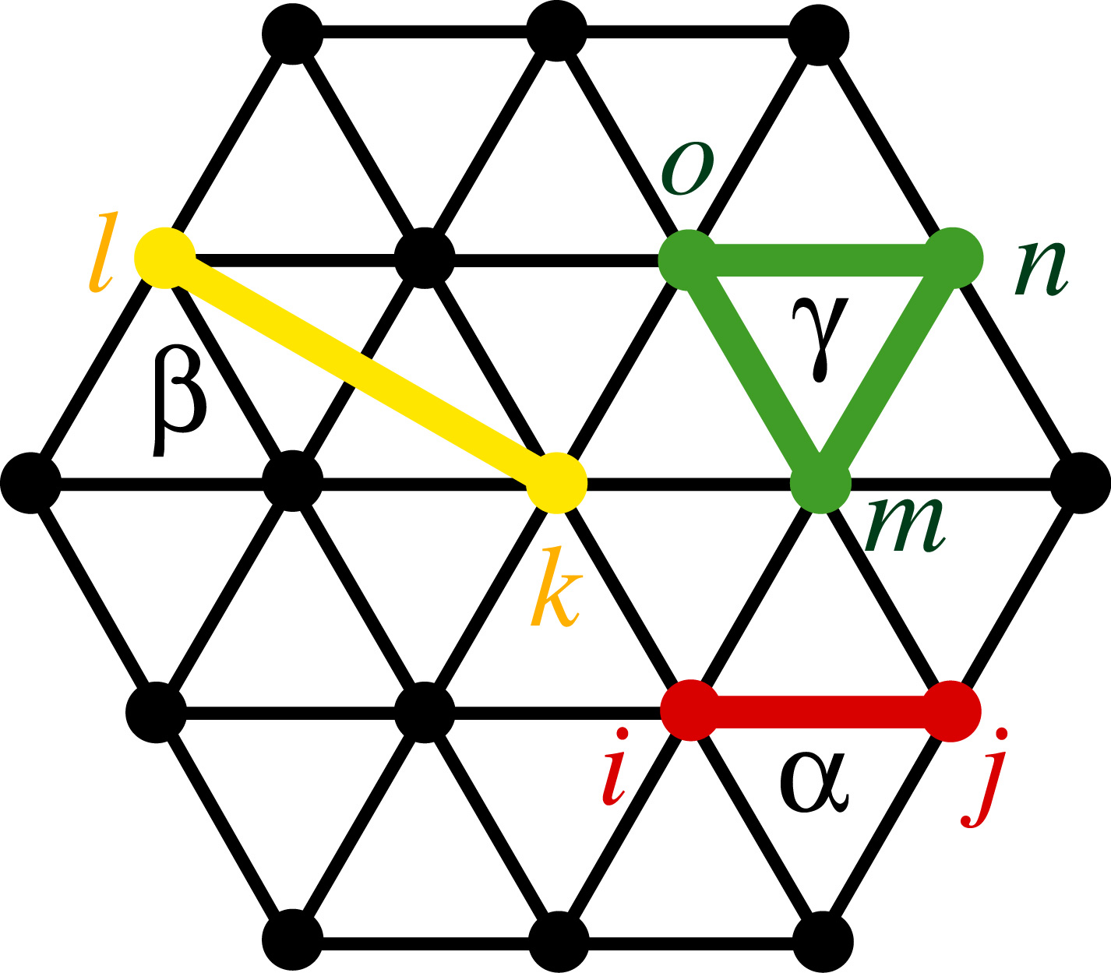
Electronic structure
Via rigorous and arbitrarily extendible cluster expansion Hamiltonians
Cluster Expansion Hamiltonians
Statistical Mechanics
Q₁
Phenomenological
descriptions
Notes:
We do this by constructing cluster expansion effective Hamiltonians in terms of atomic degrees of freedom.
These descriptions are nearly as accurate as electronic structure calculations, but orders of magnitude faster, enabling monte carlo calculations of thermodynamic and kinetic quantities.
The methods we use have many applications, but today I'll just talk about how we've applied it to basic science of the thermodynamics in the Zr-O-H system.

Slide 4
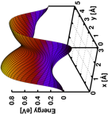
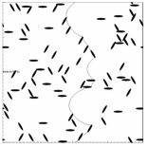
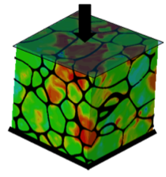
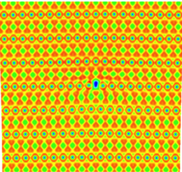
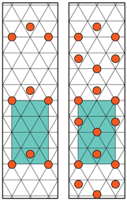
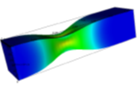
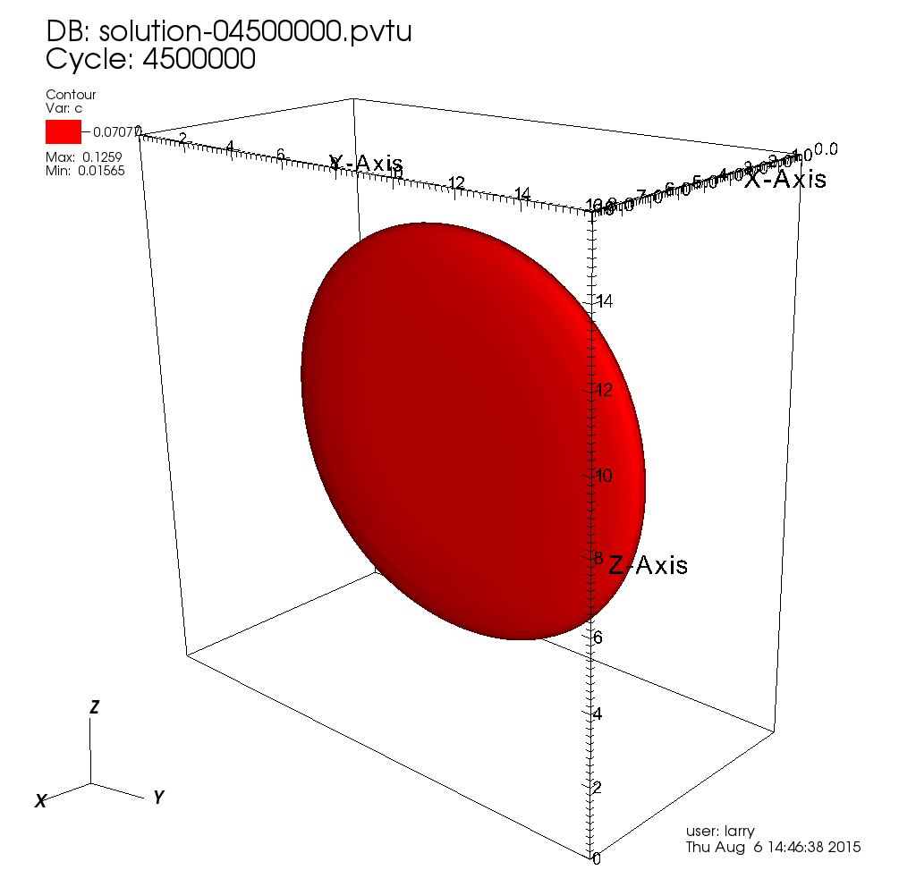
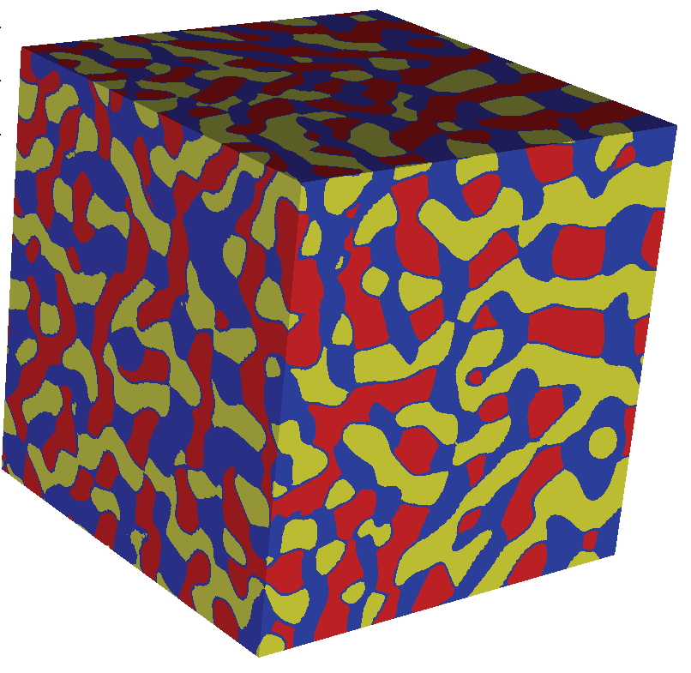

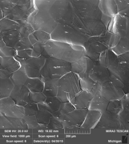
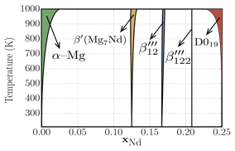


PRISMS Center Integrated Framework
Atomic scale
constitutive laws
Dislocation Dynamics
(LLNL-ParaDIS)
Crystal Plasticity
(PRISMS-Plasticity)
Real Space DFT
(PRISMS-RSDFT)
Statistical Mechanics
(CASM)
Continuum Plasticity
(PRISMS-Plasticity)
Phase Field
(PRISMS-PF)
Mechano-Chemistry
(PRISMS-MC*)
Fourier Space DFT
(VASP)
Phase Diagrams
(CASM/CALPHAD)
Experiments (slip,
twinning, crack, etc.)
Phase Field Crystal
(PRISMS-PFC*)
Experiments

Slide 5
Using ICME to Investigate Mg-Nd β’’’ Composition and Morphology
Inform problem space
Enumerate Configurations
Finite Temp. Energies
Statistical Mechanics
(CASM)
0K Energies
Precipitate Dimensions
(Validation)
Experiments
(HAADF-STEM)
Fourier Space DFT
(VASP)
Elastic Constants, Transformation Strains
Phase Field
(PRISMS-PF)
Natarajan et al., Acta Mater. 2016
Natarajan and Van der Ven, Acta Mater. 2017

Slide 6
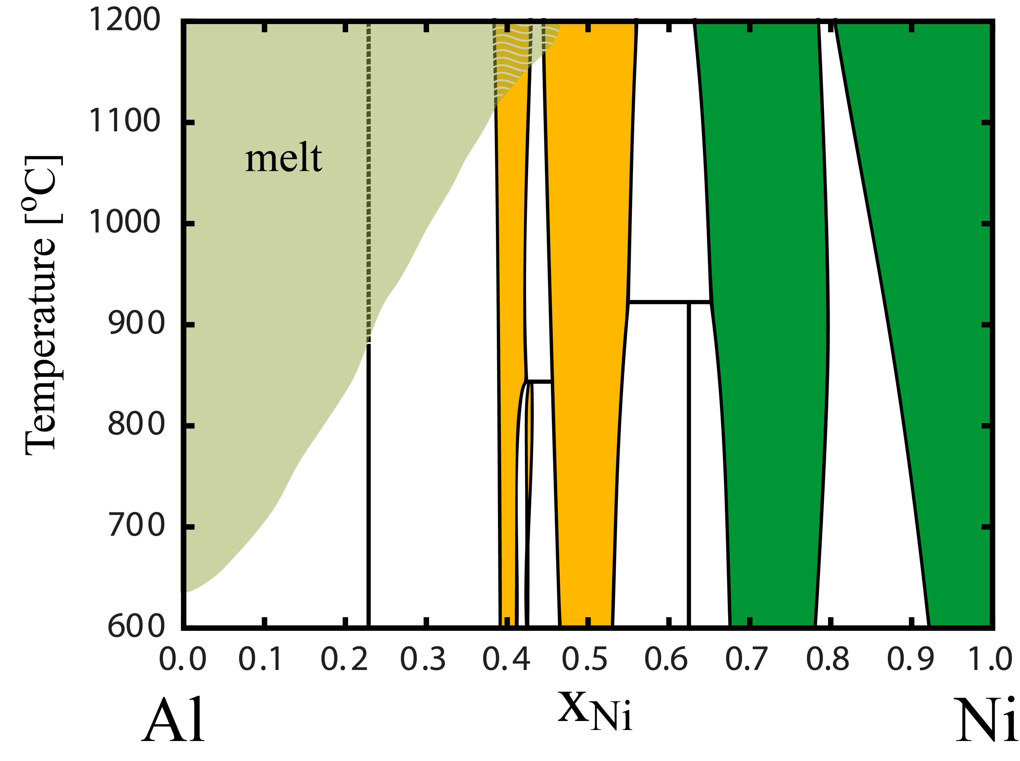
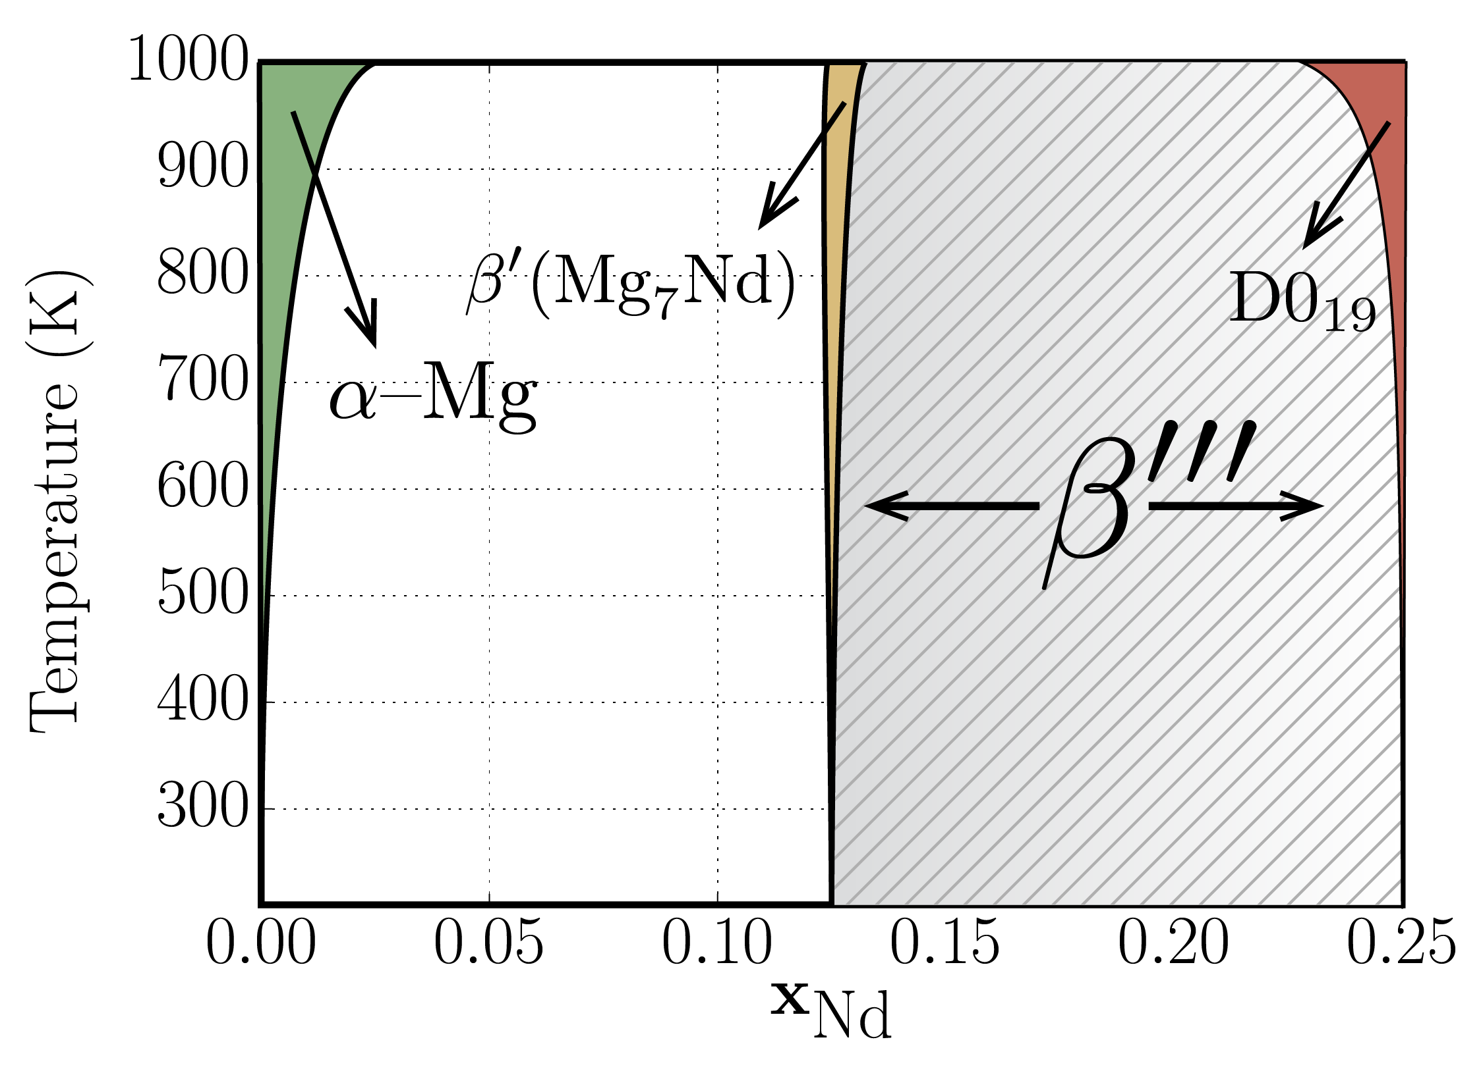
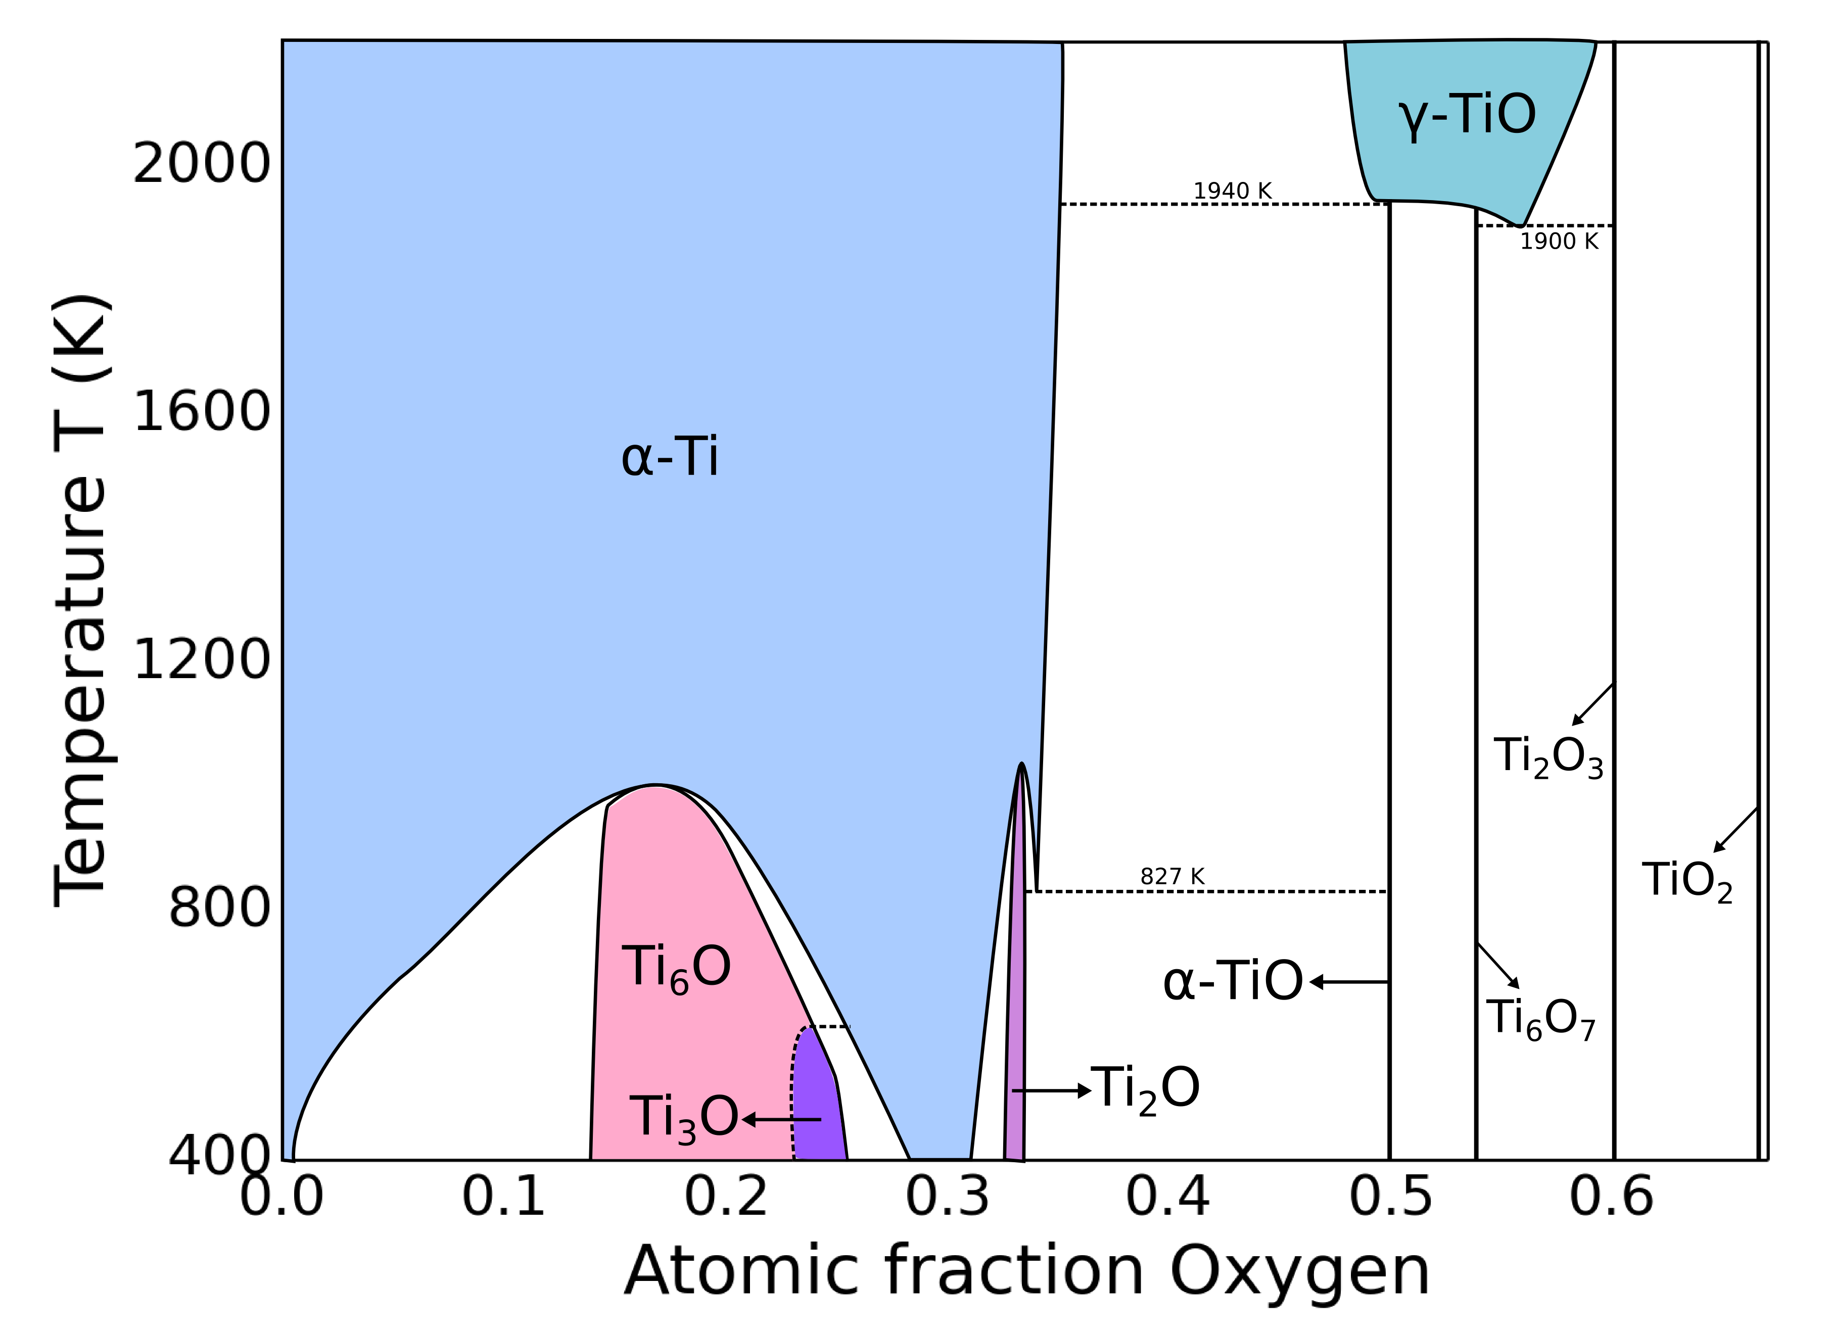
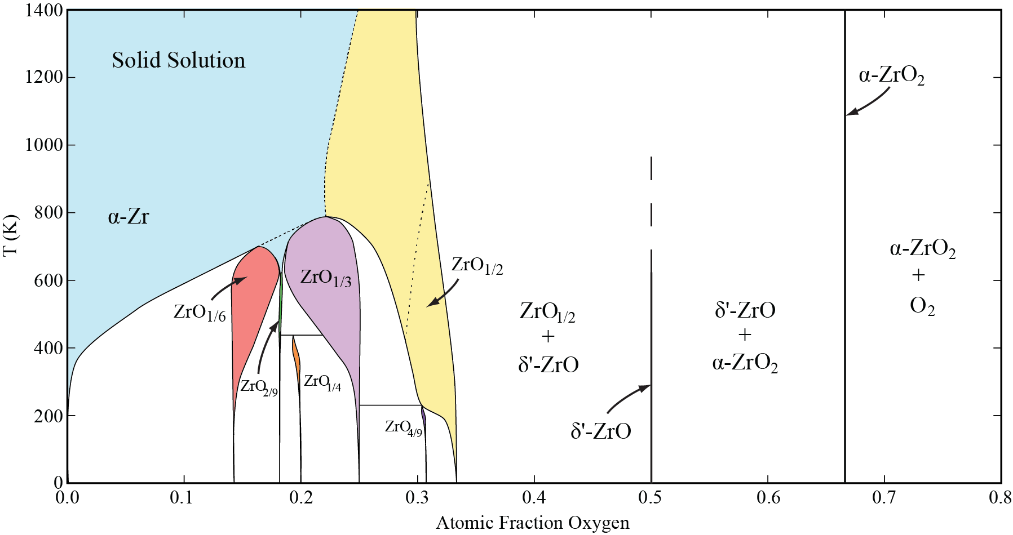
Examples: Calculated phase diagrams
Ni-Al binary
Mg-Nd binary
Ti-O binary
Zr-O binary

Slide 7
Examples: Vibrational excitations
Phonon Hamiltonian
ZrO
M. H. Chen, B. Puchala, A. Van der Ven, CALPHAD (2015).

Slide 8
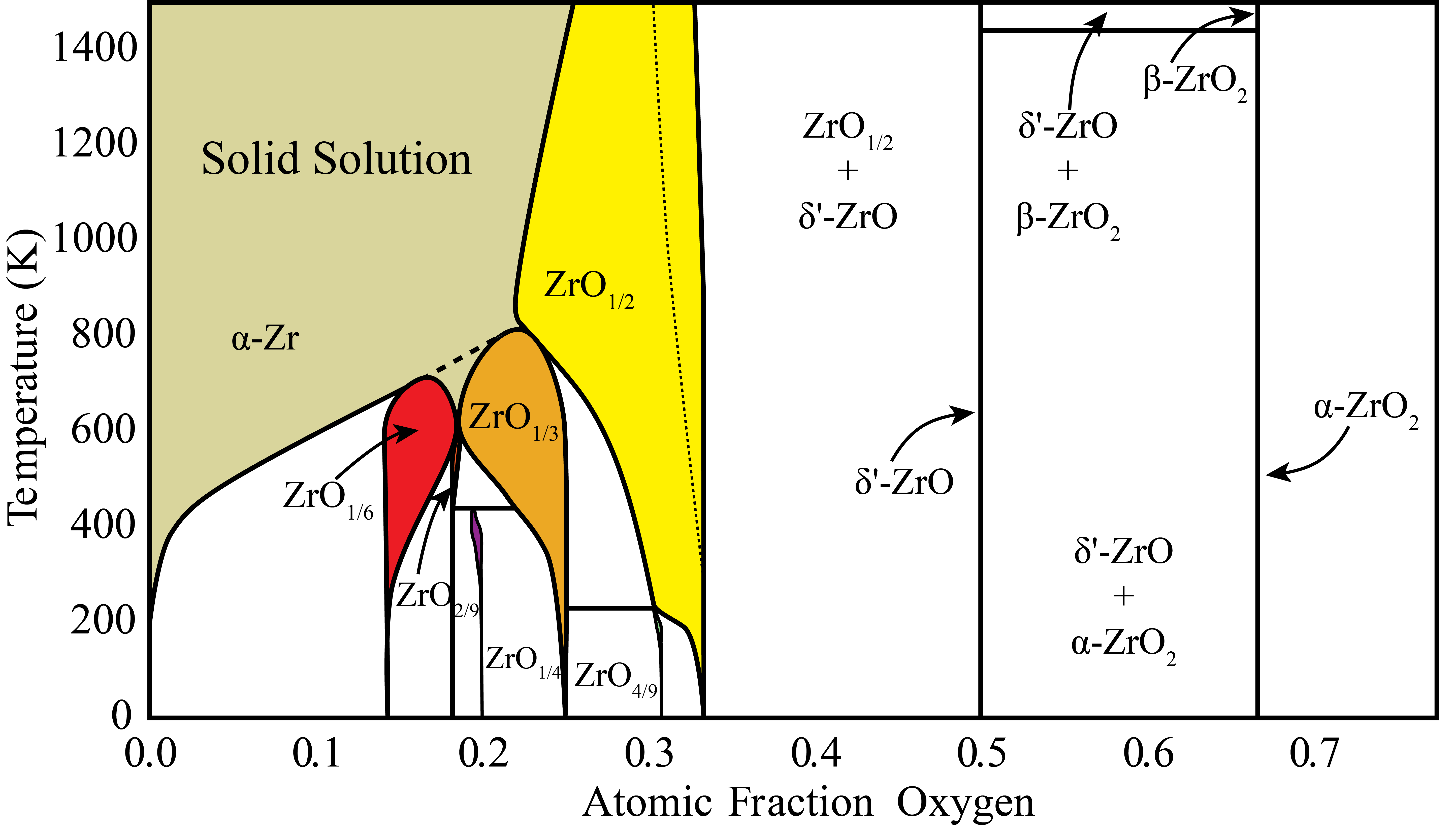
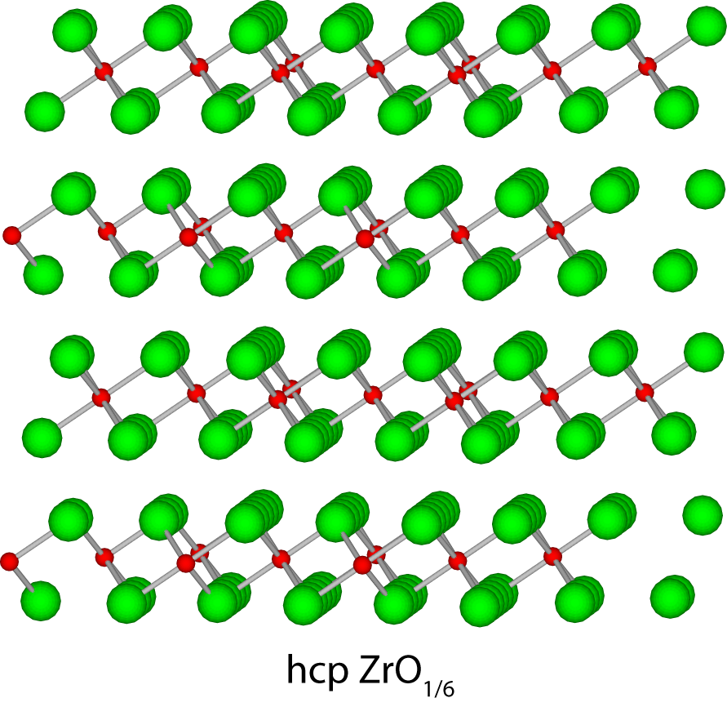
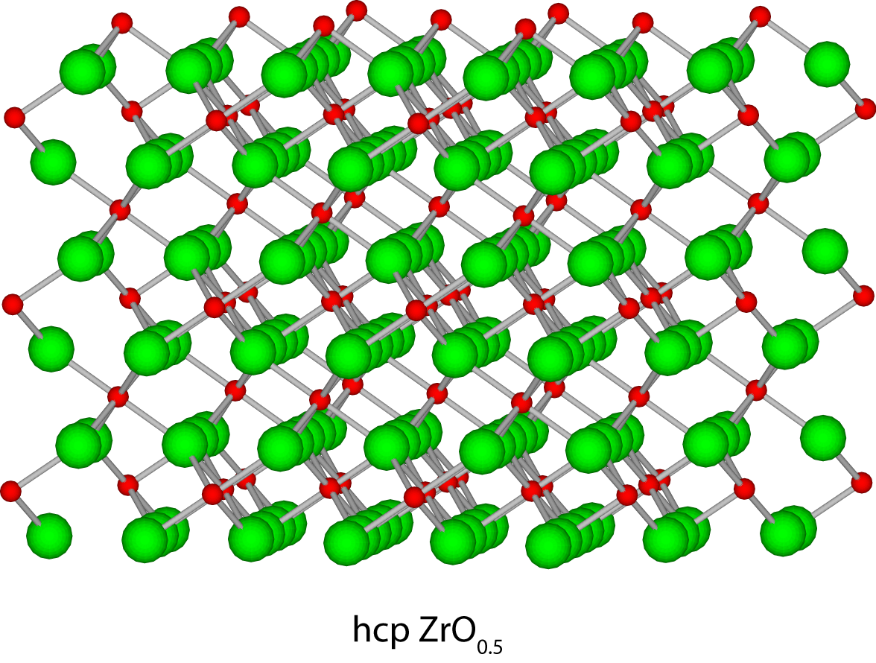
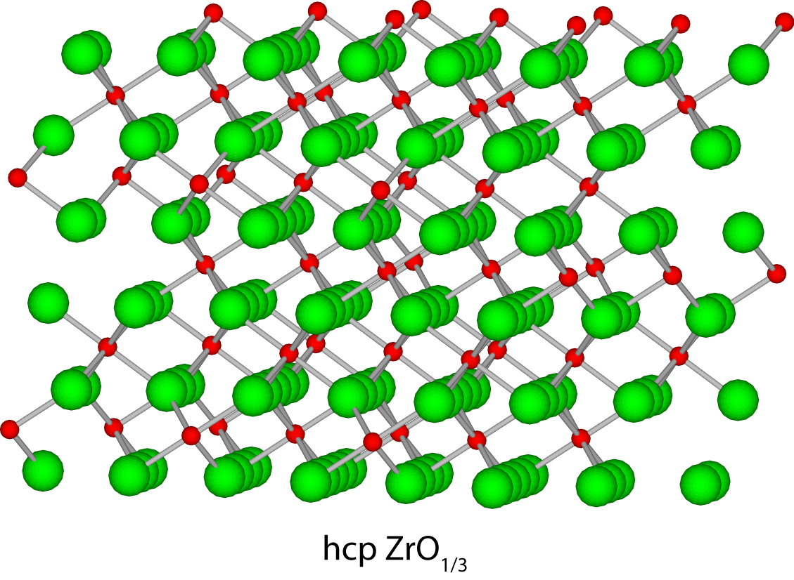
Examples: Calculated Zr-O phase diagram (configurational + vibrational excitations)
ZrO
ZrO₂
ZrO_{1/6}
ZrO_{1/3}
ZrO_{1/2}
B. Puchala, A. Van der Ven, Physical Review B, 88, 094108 (2013).
M. H. Chen, B. Puchala, A. Van der Ven, CALPHAD (2015).

Slide 9
Examples: Anharmonic vibrational cluster expansion
Energy surface with homogeneous deviotoric deformation from DFT
Cubic–tetragonal phase transition in ZrH₂
Stress-free Monte Carlo simulations
Stress free Monte Carlo
calculation
J.C. Thomas and A. Van der Ven, Phys. Rev. B 88, 214111, (2013).
J.C. Thomas and A. Van der Ven, Phys. Rev. B 90, 214105, (2014)

Slide 10
Examples: Chemo-mechanical free energy
S. Rudraraju, A. Van der Ven & K. Garikipati, npj Computational Materials 2, 16012 (2016)

Slide 11
Examples: Molecular occupation
Hybrid organic-inorganic ABX₃ perovskites: CH₃NH₃PBI₃
JS Bechtel, R Seshadri, A. Van der Ven, J. Phys. Chem. C, 120, 12403 (2016)

Slide 12
Examples: Molecular occupation
JS Bechtel, R Seshadri, A. Van der Ven, J. Phys. Chem. C, 120, 12403 (2016)

Slide 13
CASM Workflow
Problem specification
Primitive crystal structure and allowed degrees of freedom
Enumerate configurations
Electronic structure calculations:
Specify calculation parameters
Effective Hamiltonian specification:
Specify cluster expansion basis set
Fit coefficients
Evaluate effective Hamiltonian:
Monte Carlo calculation of ensemble averages
Evaluate strain polynomials
Fit phenomenological models
Free energy, mobilities
For analysis and as input to models at greater time/length scales

Slide 14
CASM Design Principles
Flexibility
CASM provides a set of tools and enables customization at many steps
As much as possible, CASM does not force you to use a particular method for enumeration, calculation, model fitting, etc.
Reproducibility
Log all commands over the course of a project
Try to record provenance of all data as part of normal workflow
Data Management and Automation
Tools to generate, screen, and dispatch DFT calculations, and then organize, filter, and analyze the results.
Managed directory tree and dependency framework that allows multiple calculation and model parameters to be tested and compared within a single project

Slide 15
CASM Design Principles
Interoperability
Most input and output files are stored in JavaScript Object Notation (JSON) file formats, which is widely used and highly readable.
Weak coupling between CASM and DFT codes, so that CASM can be adapted to work with various existing and future codes.
Collaboration
Easy archival of projects (‘casm files’ command), with granular control over amount and type of data to include.
Parameterized physics models can be shared without DFT training data and used to perform finite-temperature calculations
Efficiency
CASM implements unique and highly optimized algorithms for generating and analyzing data and building physics models.
CASM generates optimized C++ code to evaluate basis functions which is automatically compiled and used in the Monte Carlo code, enabling larger simulations and improved convergence.

Slide 16
CASM Components:
"casm" command line executable, with JSON input files
C++11 for "core" (symmetry, crystallography, basis sets, Monte Carlo)
Doxygen documentation
Python wrappers, visualization, analysis
"casm" Python module for standard usage interfaces
DFT software wrappers for VASP & SeqQuest
"casm-learn" coefficient fitting integrates with scikit-learn, deap (genetic algorithms)
Easy integration with VESTA for viewing configurations
Interactive visualization
Python PBS & Slurm interface for cluster job submission:

Slide 17
CASM Components:
Public version:
Occupation DoF & grand canonical Monte Carlo calculations
"beta" canonical Monte Carlo calculations enabling a large number of possible occupation constraints
Variance-constrained Monte Carlo to be released very soon
Available on github:
https://github.com/prisms-center/CASMcode
Demo project with pre-calculated DFT training data:
https://github.com/prisms-center/CASMcode_demo

Slide 18
Near Future (next 0-2 yrs):
Much of this is also completed in part or in full internally, and needs to be completed or polished in some way for the public code.
Kinetics:
Enumeration of atomic hops and local configurations, NEB calculation, local cluster expansion of activation energy, KMC
Phonons:
Enumerate configurations for force constant calculation, dynamical matrix calculation, free energy calculation in quasi-harmonic approximation
Strain polynomials:
Generate symmetrized strain Hamiltonian, enumerate strained configurations, DFT calculation, fit Hamiltonian coefficients
Gamma-surface:
Setup gamma-surface geometries and perform DFT calculations
Composition & configurational order parameter dependent free energies
Specify ordered configurations, generate order parameter, perform variance-constrained Monte Carlo calculations and free energy integration
Machine learning tools for optimal design of Monte Carlo calculations
Integration with Materials Commons

Slide 19
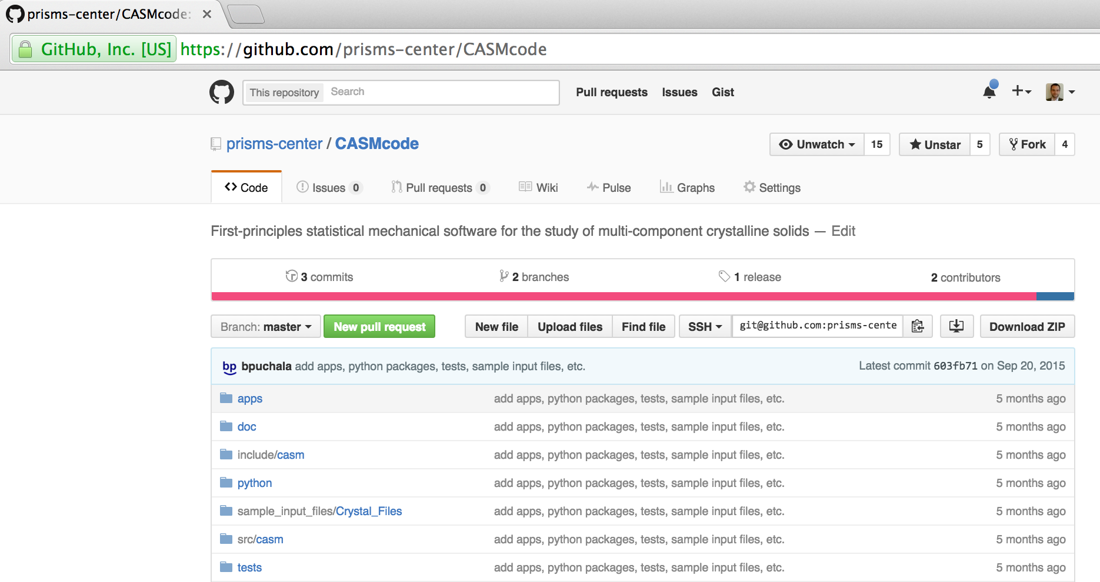
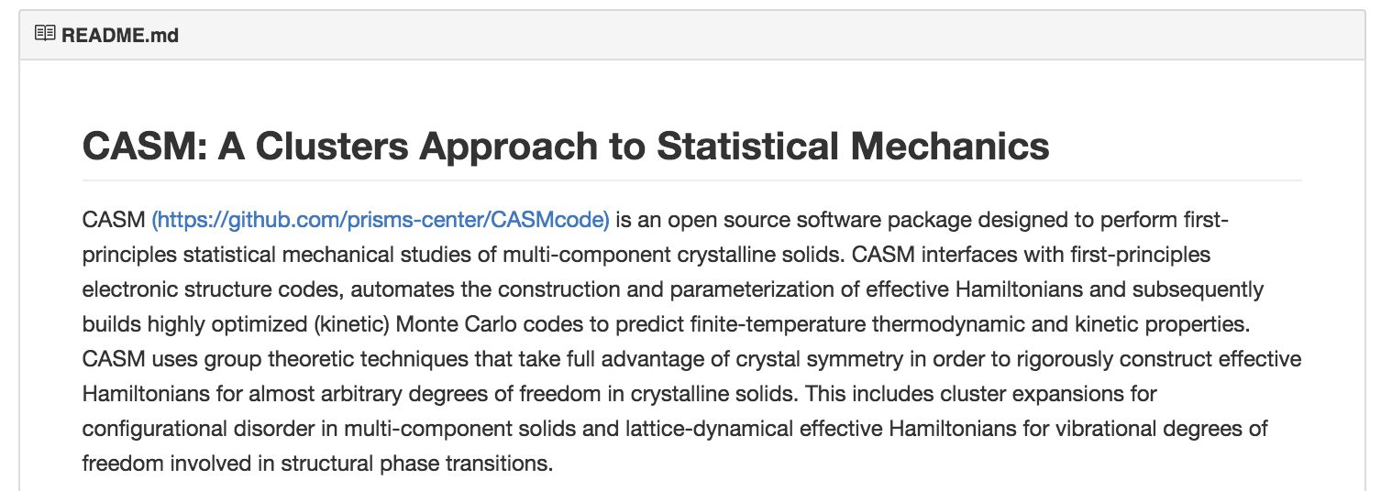
v0.2.1 Now Available!

